Slide 1
Welcome to Bayesian CBIOMES
January 8-10, 2020 Massachusetts Institute of Technology
Instructors: Michael Dowd (mdowd@mathstat.dal.caa) Gregory Britten (gbritten@mit.edu) Paul Mattern (jmattern@ucsc.edu)

Slide 2
INTRODUCTIONS Who are you, where do you work, and what do you work on? What’s your stats and non-stats background? What do you want to get out of the workshop?

Slide 3
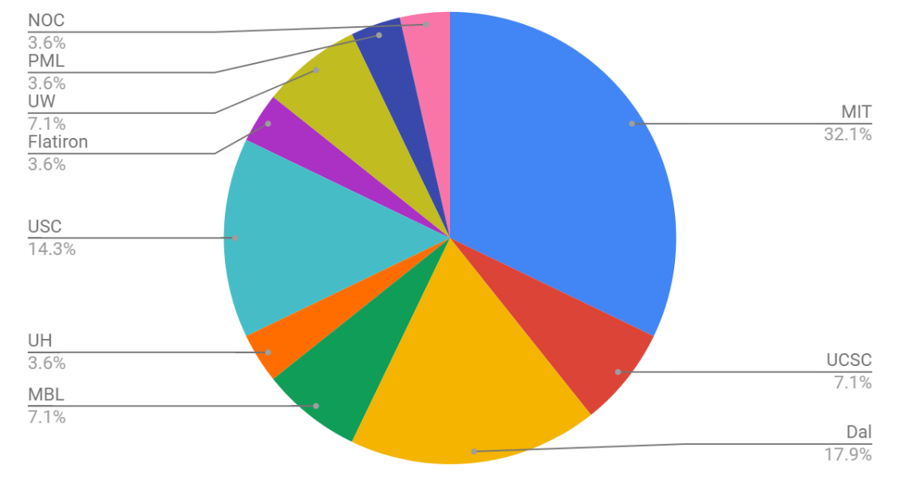
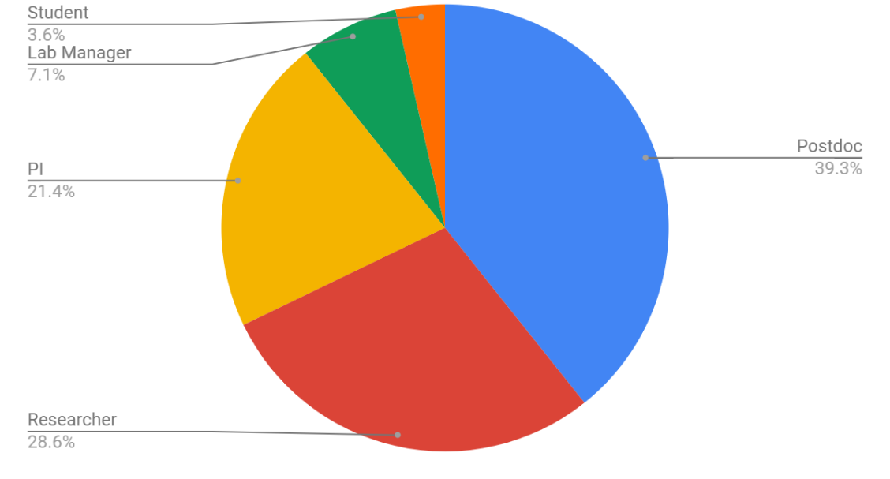
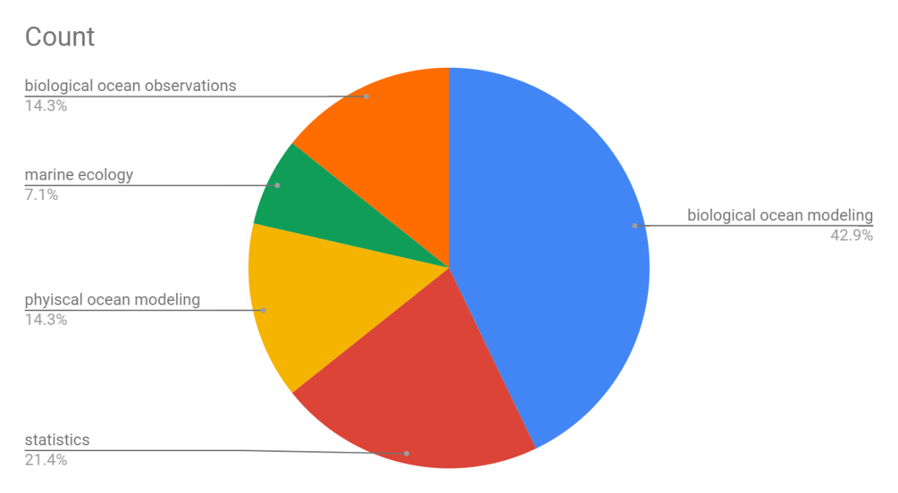
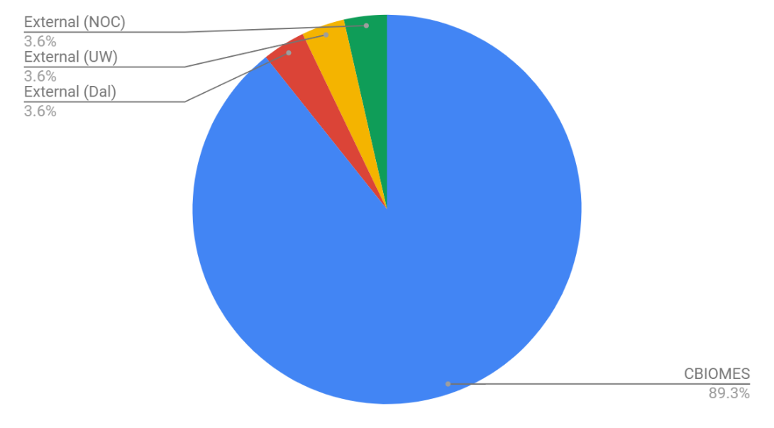
Our inter-disciplinary breakdown
Institution
Academic Level
Primary Research Category
Project Affiliation

Slide 4
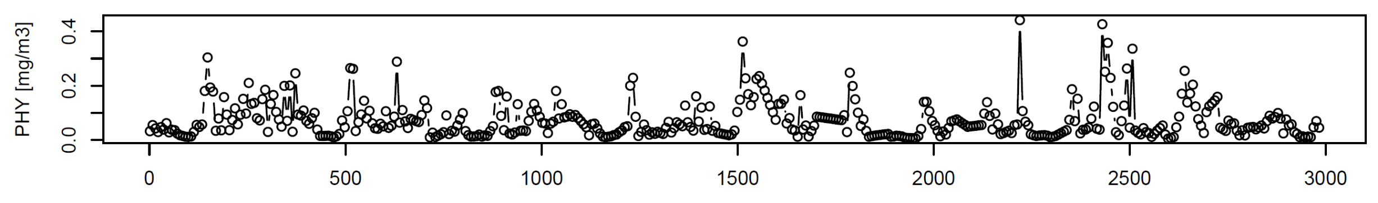

Goal: Bayesian analysis of dynamic biological marine systems
Dynamic systems that vary with respect to time
Biological information in rate processes and system interactions
Use Bayesian analysis to learn information from noisy time series observations
Will work through four CBIOMES-relevant case studies as examples and/or projects that we can contribute to

Slide 5
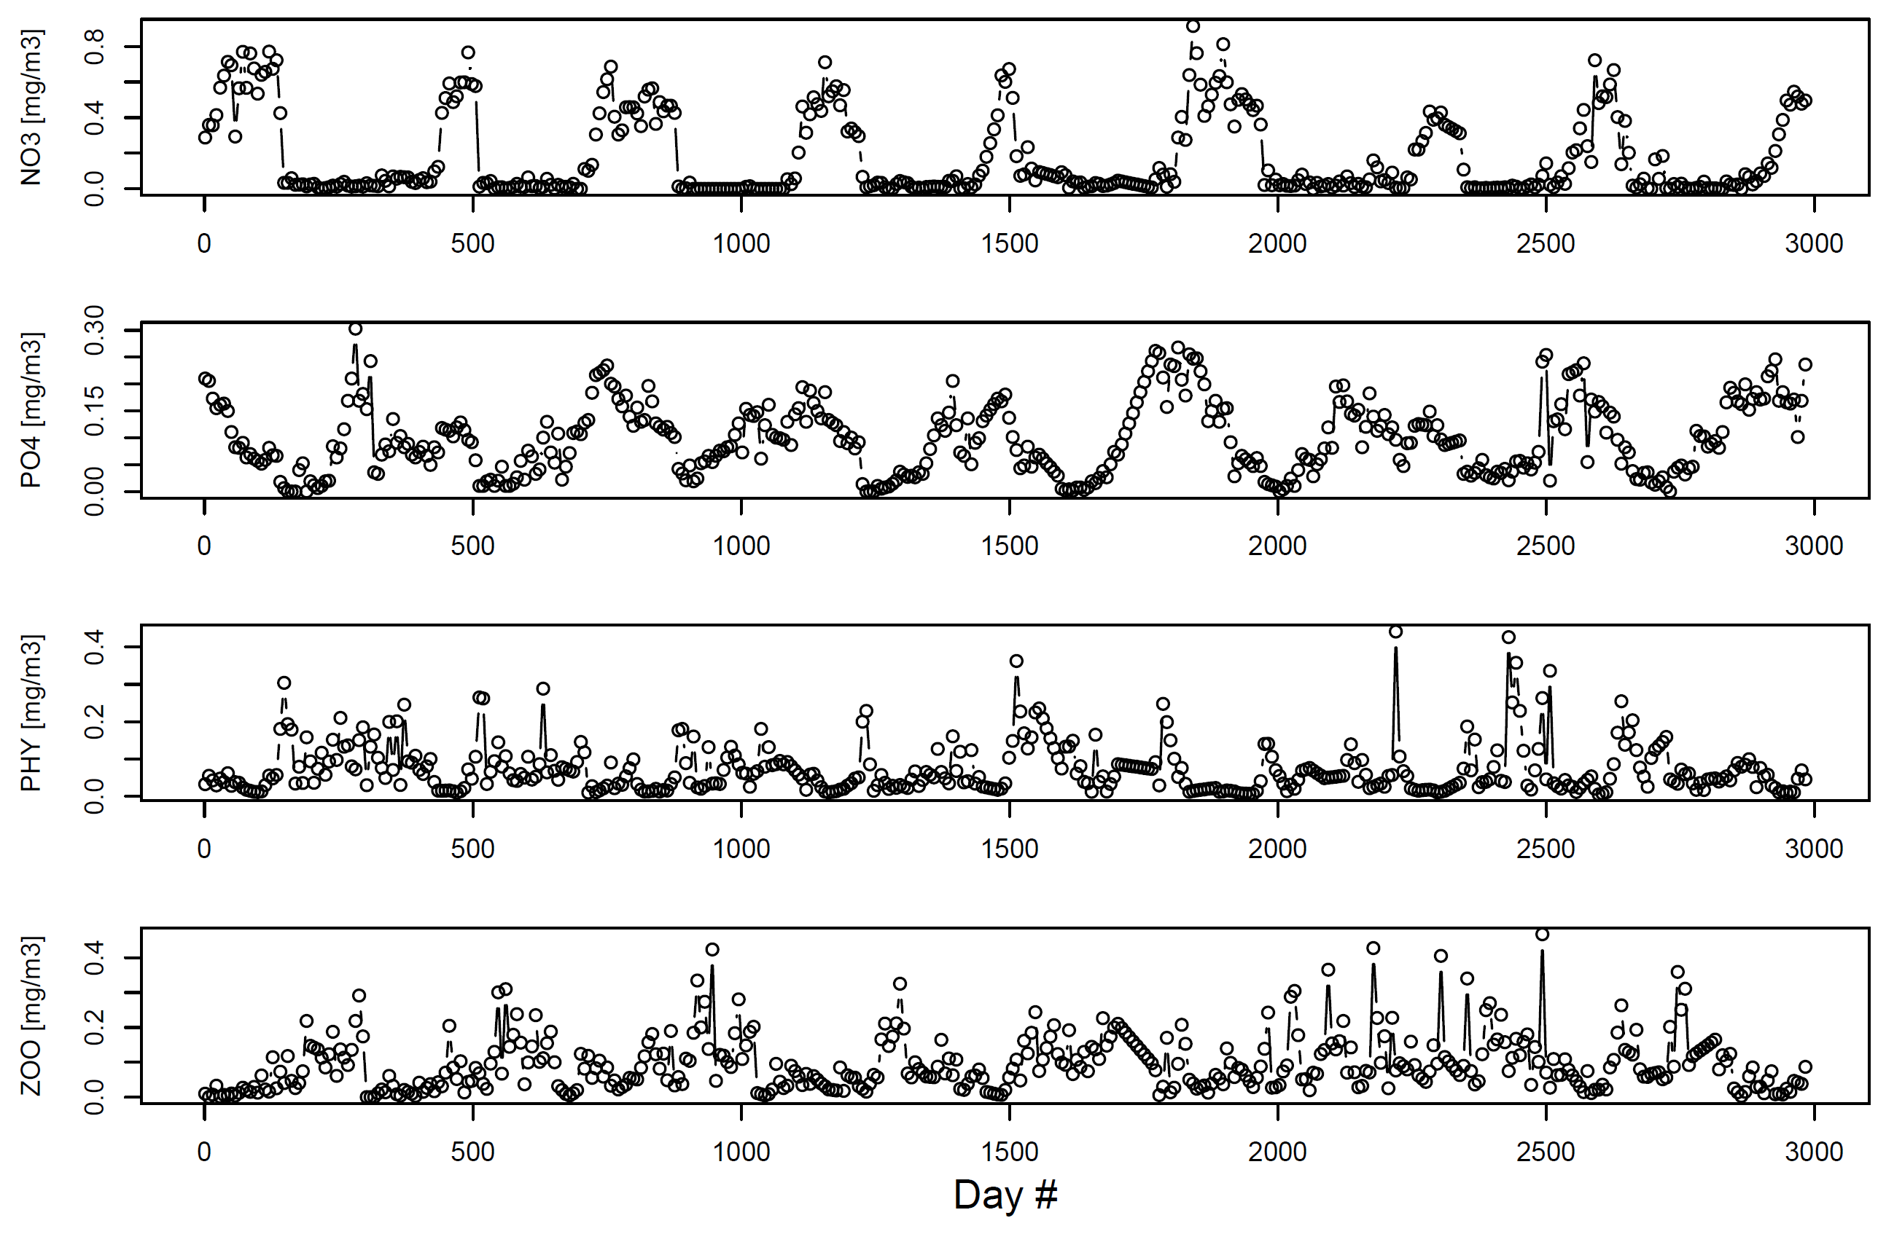
Dynamic systems: Case Study: Narragansett Nutrients-Phytoplankton-Zooplankton
A multivariate time series from Narragansett Bay, Rhode Island

Slide 6
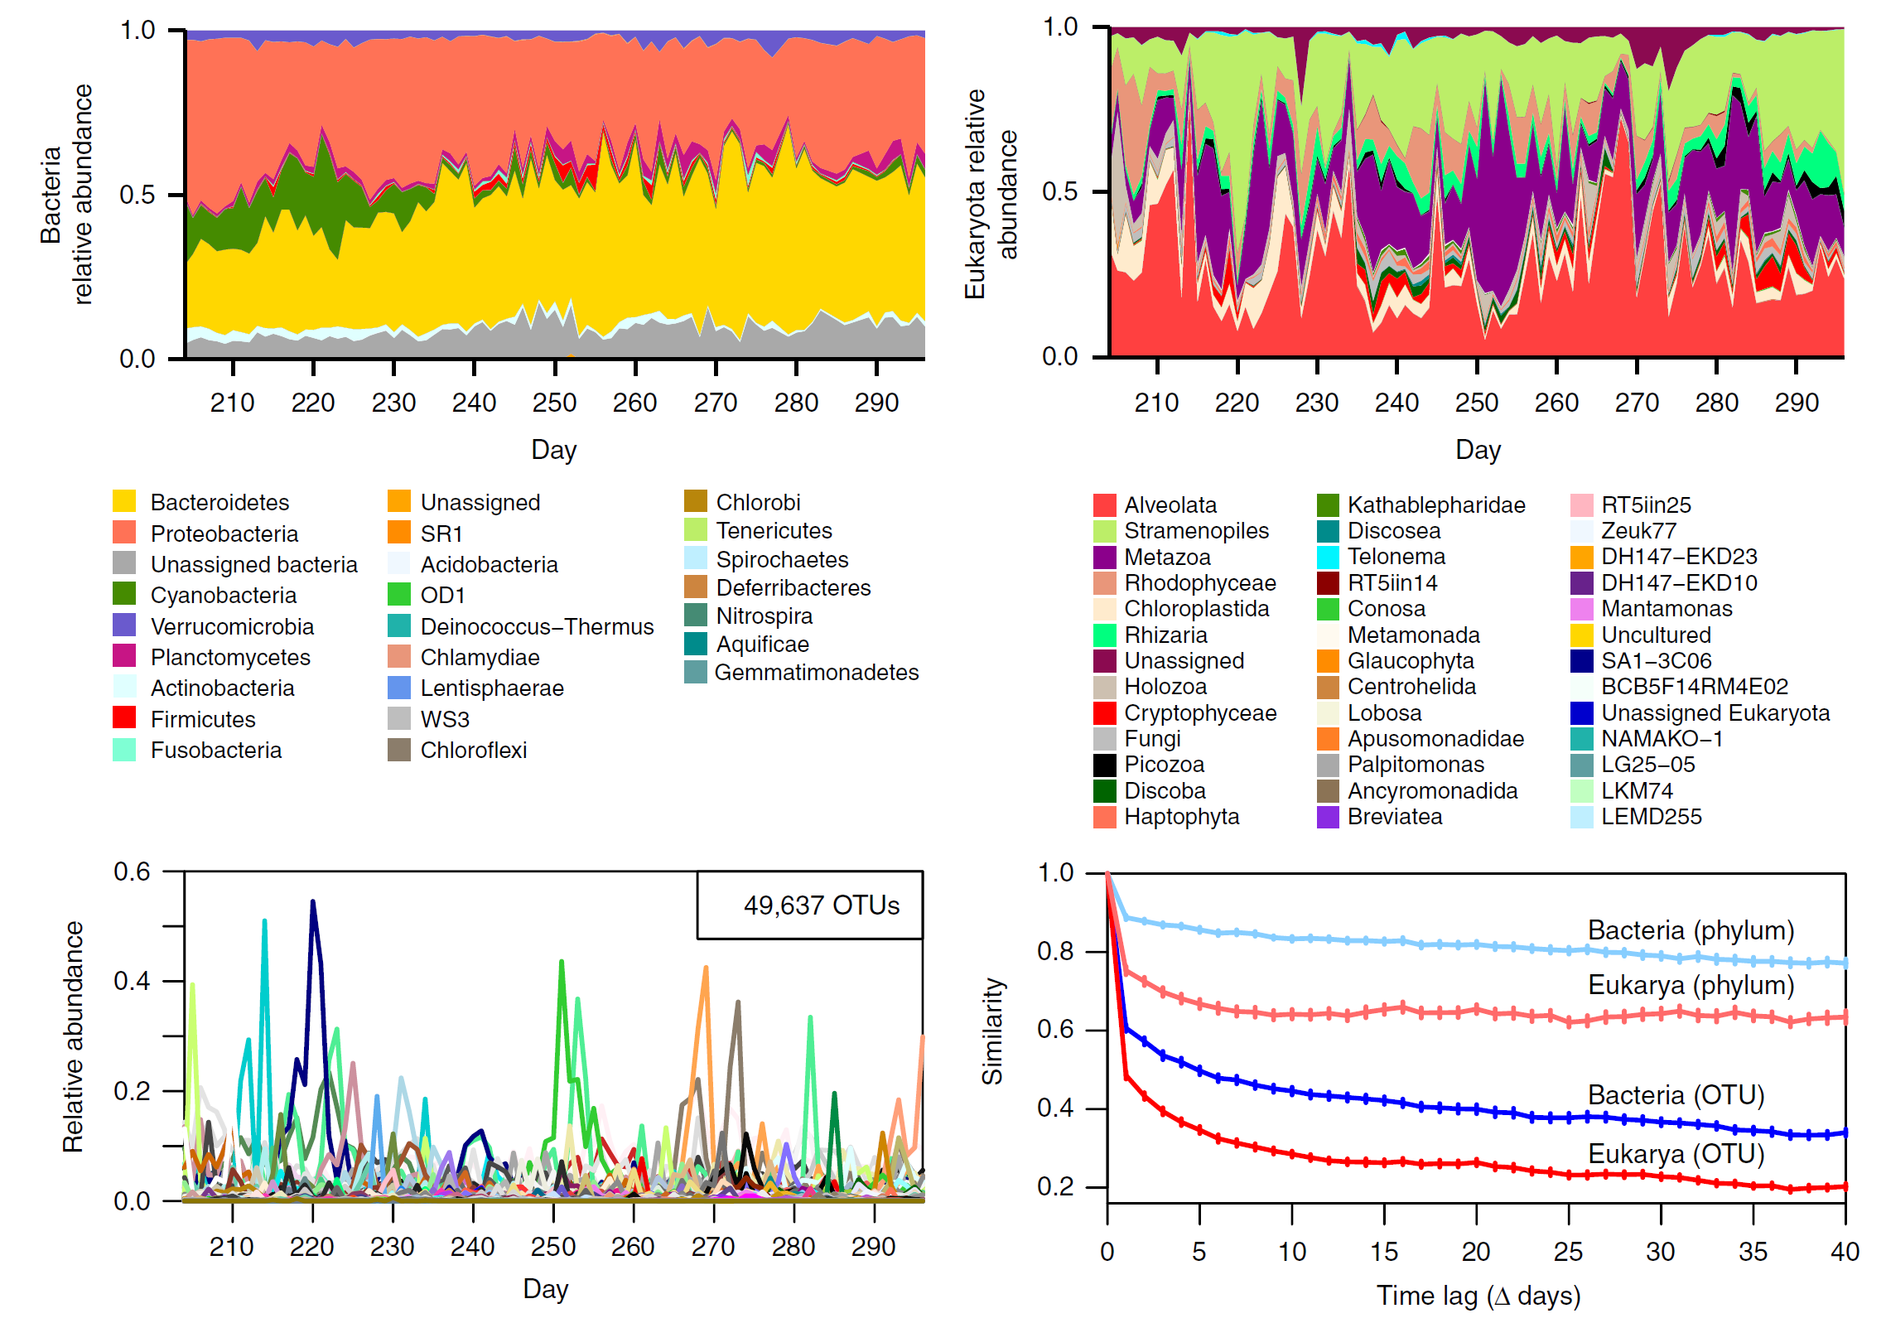
Dynamic systems: Case study: Multivariate bacterial OTUs

Slide 7
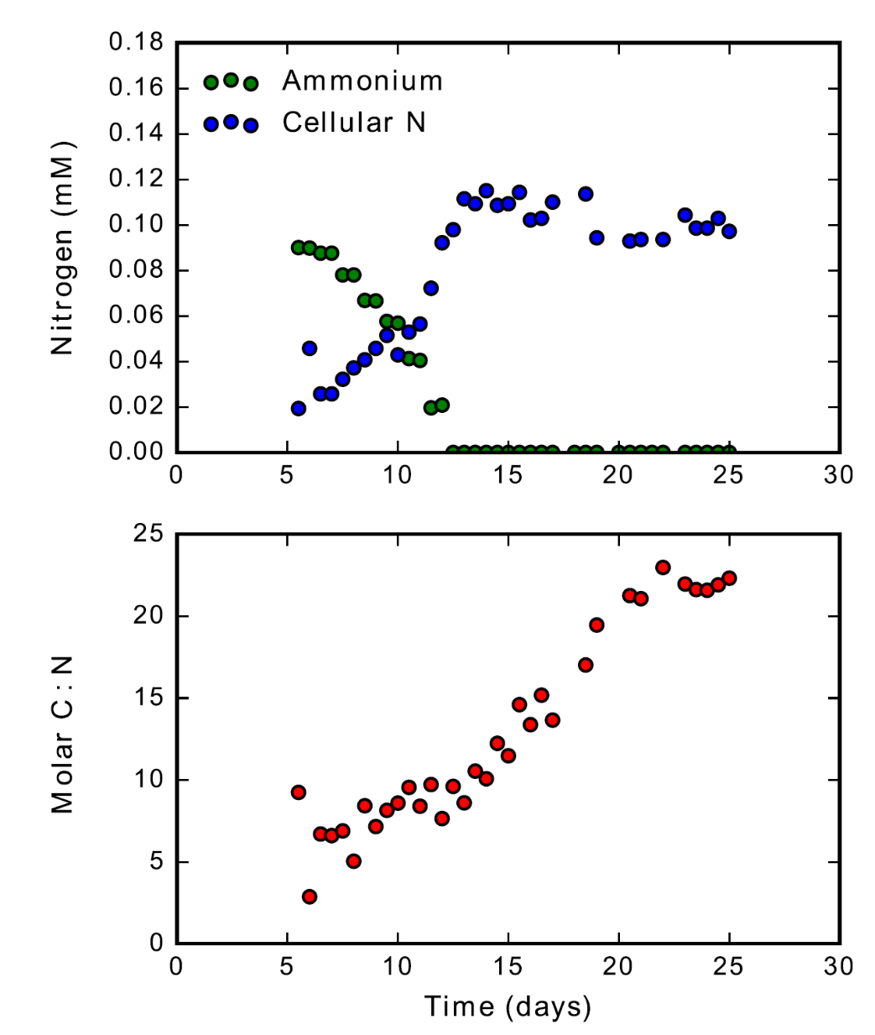
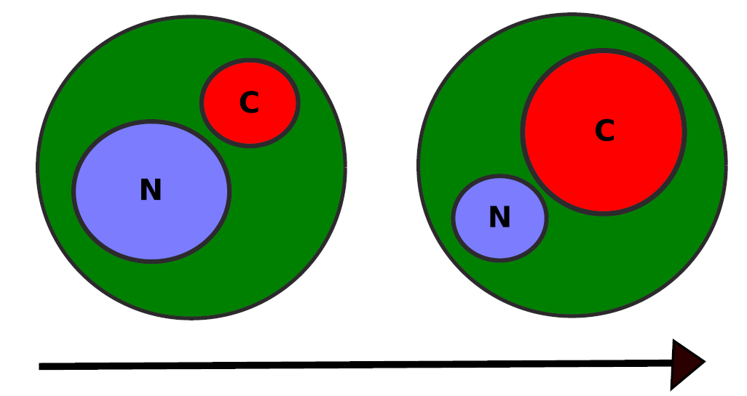
Dynamic systems: Intra-cellular macromolecules

Slide 8
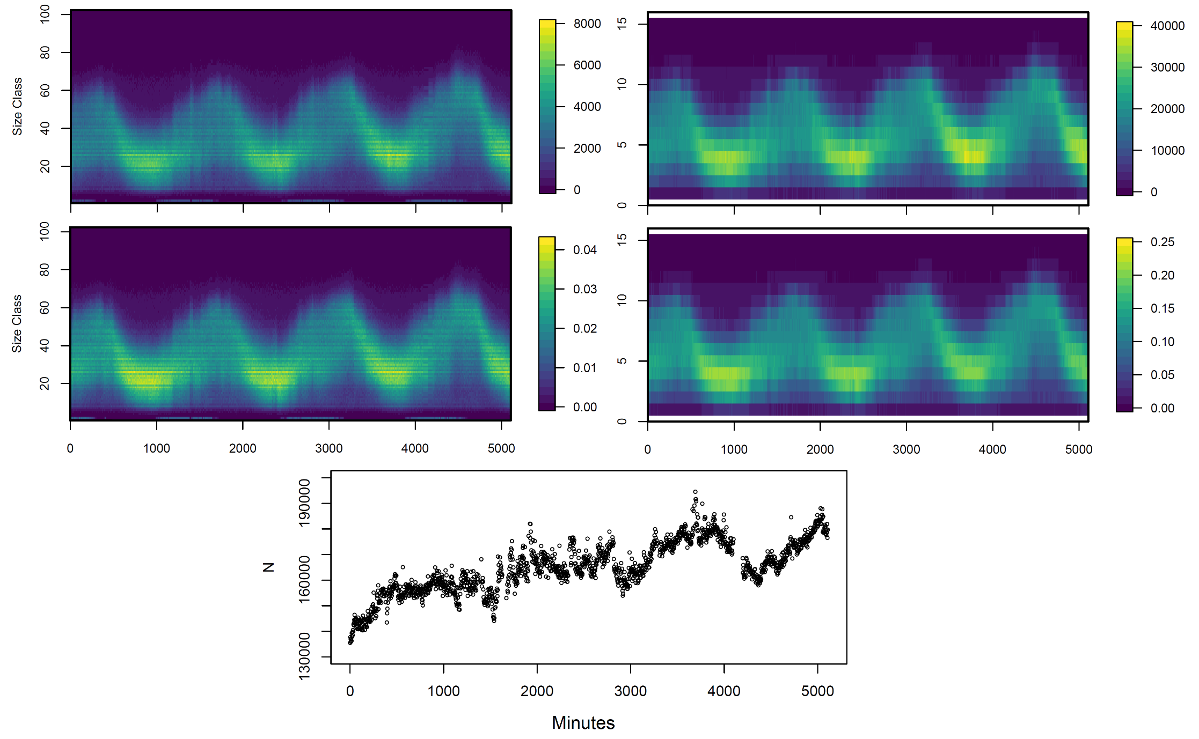
Dynamic systems: Cellular size distributions over the cell cycle

Slide 9
Outline of workshop
Day #1
Introductions
GitHub orientation
Brief intro to Bayes’ theorem
Bayesian analysis of dynamical systems
MCMC with and without Stan using linear regression and a simple phytoplankton growth model
Case study #1: Fitting an NPZ model
Day #2
Case study #2: Linear autoregressive model fit to multivariate OTU time series
Case study #3: Intracellular macromolecular pool dynamics
Case study #4: Fitting cell cycle models to diel size distribution time series
Form case study groups and brainstorm analysis ideas
Discuss analysis ideas as a group
Day #3
Analysis hackathon!
Presentations of analyses

Slide 10
GitHub/notebook orientation
Can use materials with/without GitHub and with/without Jupyter
Forking, cloning, pulling, and pushing
Download as zip
Lecture materials
Case study folders
Notebooks and scripts

Slide 11
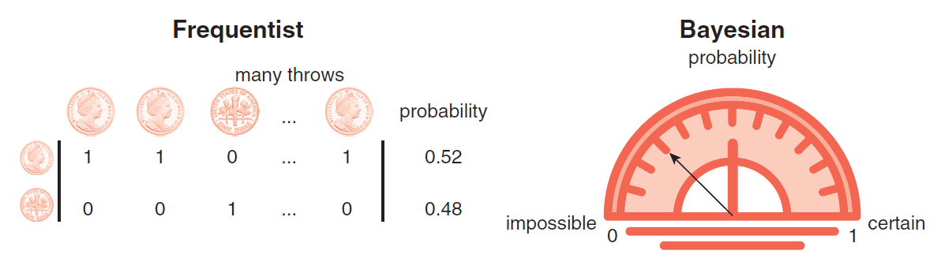
Why Bayesian inference? A more principled way to learn from data in the presence of uncertainty
#0 Concepts of probability
Two concepts of probability: long-run frequencies vs. state of knowledge
Bayesians describe all unknowns with probability
Frequentists only use probability to describe data uncertainty
Frequentists find the parameters that maximize the probability of the data, assuming the model is true and that all error comes from sampling noisy data; limited ability to describe parameter or model uncertainty
Bayesians assign prior probabilities to their belief about certain parameters, update those priors using Bayes’ rule according to how consistent they are with the data; can characterize uncertainty in a much broader and general way
BIOLOGY IS FULL OF UNCERTAINTY AND REQUIRES PROPER ACCOUNTING TO MAKE ROBUST INFERENCES
#1 Interpretability of probabilities
Results in terms of uncertainties/intervals straightforward to interpret
Results are directly carried forward to predictions
A lot of information about parameter co-dependencies in the joint posterior distribution
#2 The usefulness of prior distributions
Allows us to rigorously quantify our prior scientific knowledge about a process and unknown quantities in the calculations
Prior and observational knowledge naturally blend propagate forward through subsequent calculations
#3 Mathematical consistency, simplicity, and transparency
ONE PROCEDURE FOR ALL INFERENCE PROBLEMS
Modifications are transparent – usually manifest as choices of prior distribution or limited search parameters
More computationally challenging, less so with software and hardware advancements

Slide 12
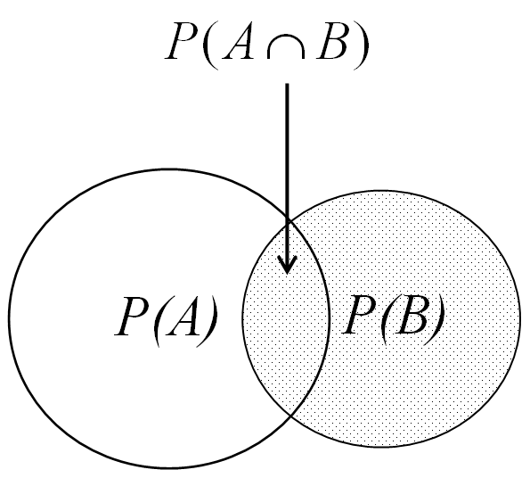
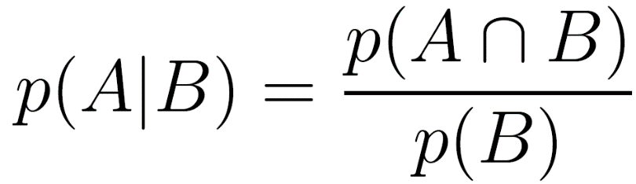
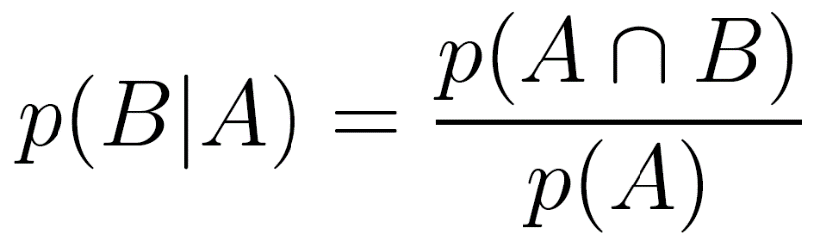
Bayes theorem is extremely simple to derive

Slide 13
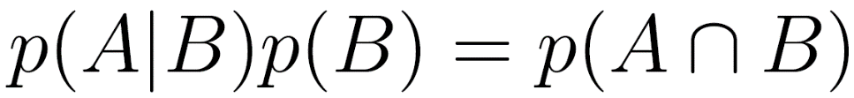
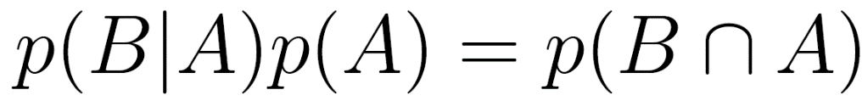
Bayes theorem is extremely simple to derive

Slide 14
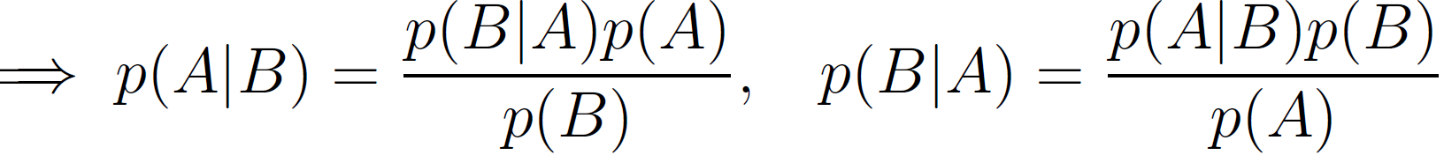
Bayes theorem is extremely simple to derive

Slide 15
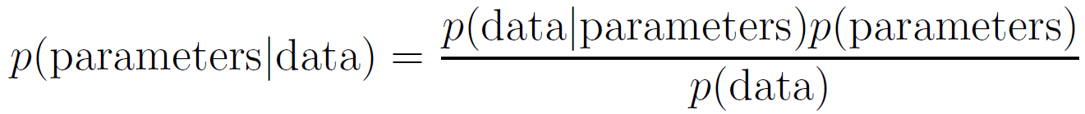
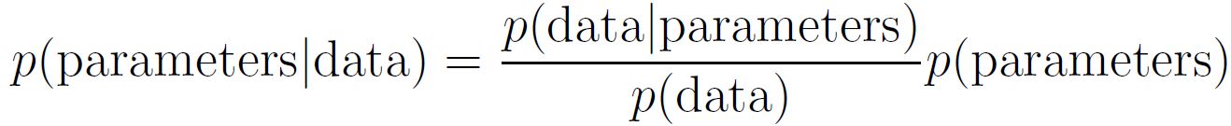
Understanding Bayes’ theorem can be more subtle
This quotient quantifies the explanatory power of parameter values relative to others
It is a normalized and therefore ‘weights’ the parameters according to how well they fit the data
The product of the prior and relative goodness of fit weights gives us the posterior
p(Data)
p(Parameters₁)
p(Parameters₂)

Slide 16
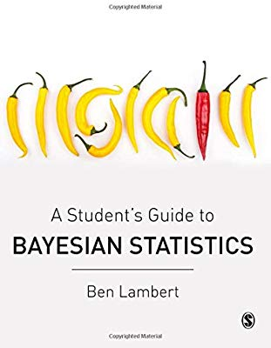
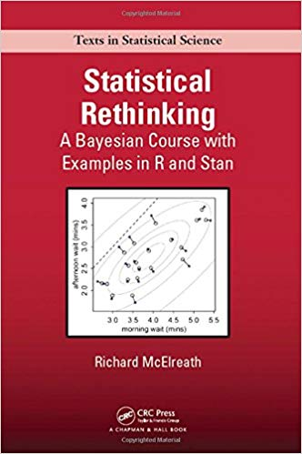
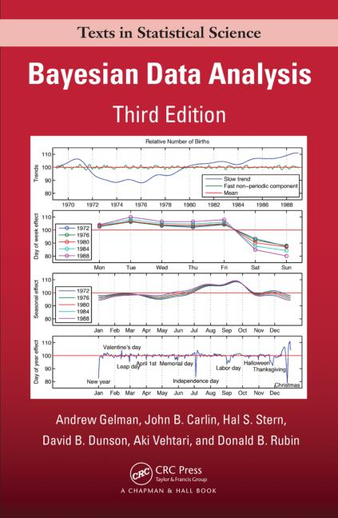
Bayesian resources

Slide 17
MIKE SLIDES

Slide 18
Introducing Stan
A sophisticated C++ software package for performing efficient MCMC that can be interfaced with R, Python, Julia, Stata, Mathematica, Matlab, or called from command line
R and Python best supported, followed by Command Line, increasing support for Julia, less well supported for others (version cross-compatibility, etc.)
Write your model and specify parameters in the C++ template (i.e. the ‘Stan language) and Stan will do the rest
Stan code identical when called from various languages, so easy to share
Implements a version of ‘Hamiltonian Monte Carlo’ which has many practical advantages and is much faster than random walk MH

Slide 19
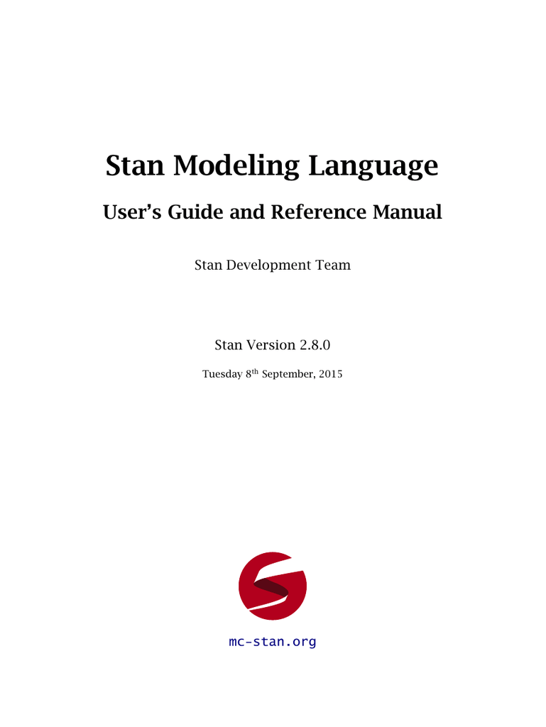


Slide 20
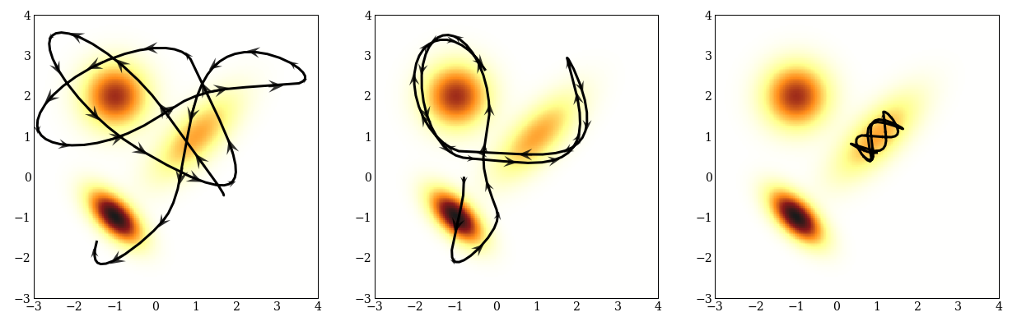
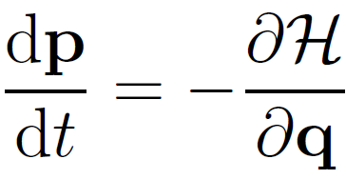
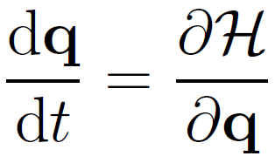
A brief and relatively uninformed description of Hamiltonian Monte Carlo
Hamilton’s equations are a reformulation of Newton’s laws into a phase space of generalized coordinates
The Hamiltonian describes the sum of potential and kinetic energies
The Hamiltonian dynamics in phase space describe the time evolution of a classical mechanical system
In HMC, we describe the potential energy as the negative log(posterior) and choose a Gaussian function for the kinetic energy
Integrate the Hamiltonian forward in time to traverse the posterior
Integration time and variance of the kinetic energy determine the efficiency of the exploration
Due to compiling time and tuning operations, Stan can (sometimes) be slower than RWMH for simple, very low dimensional models
Speed and efficiency increase rapidly with the dimension of parameter space to explore

Slide 21
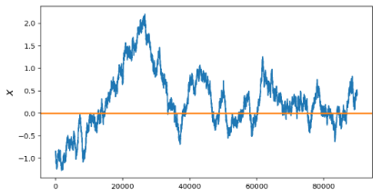
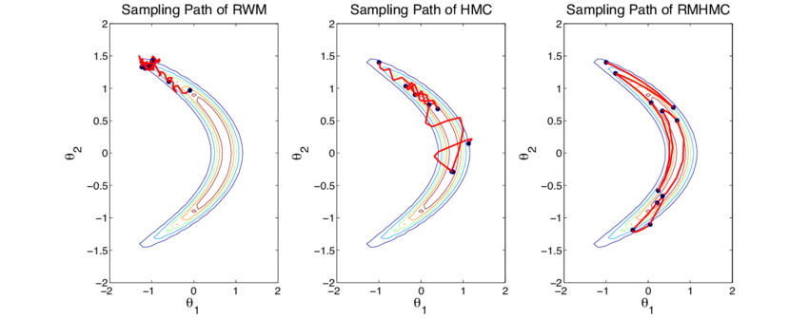
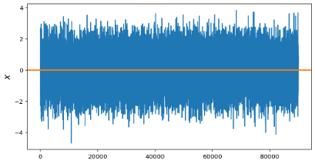
Sampling efficiency of HMC
Random walk MCMC chain
Random walk MCMC
Hamiltonian MC
Hamiltonian MC chain

Slide 22
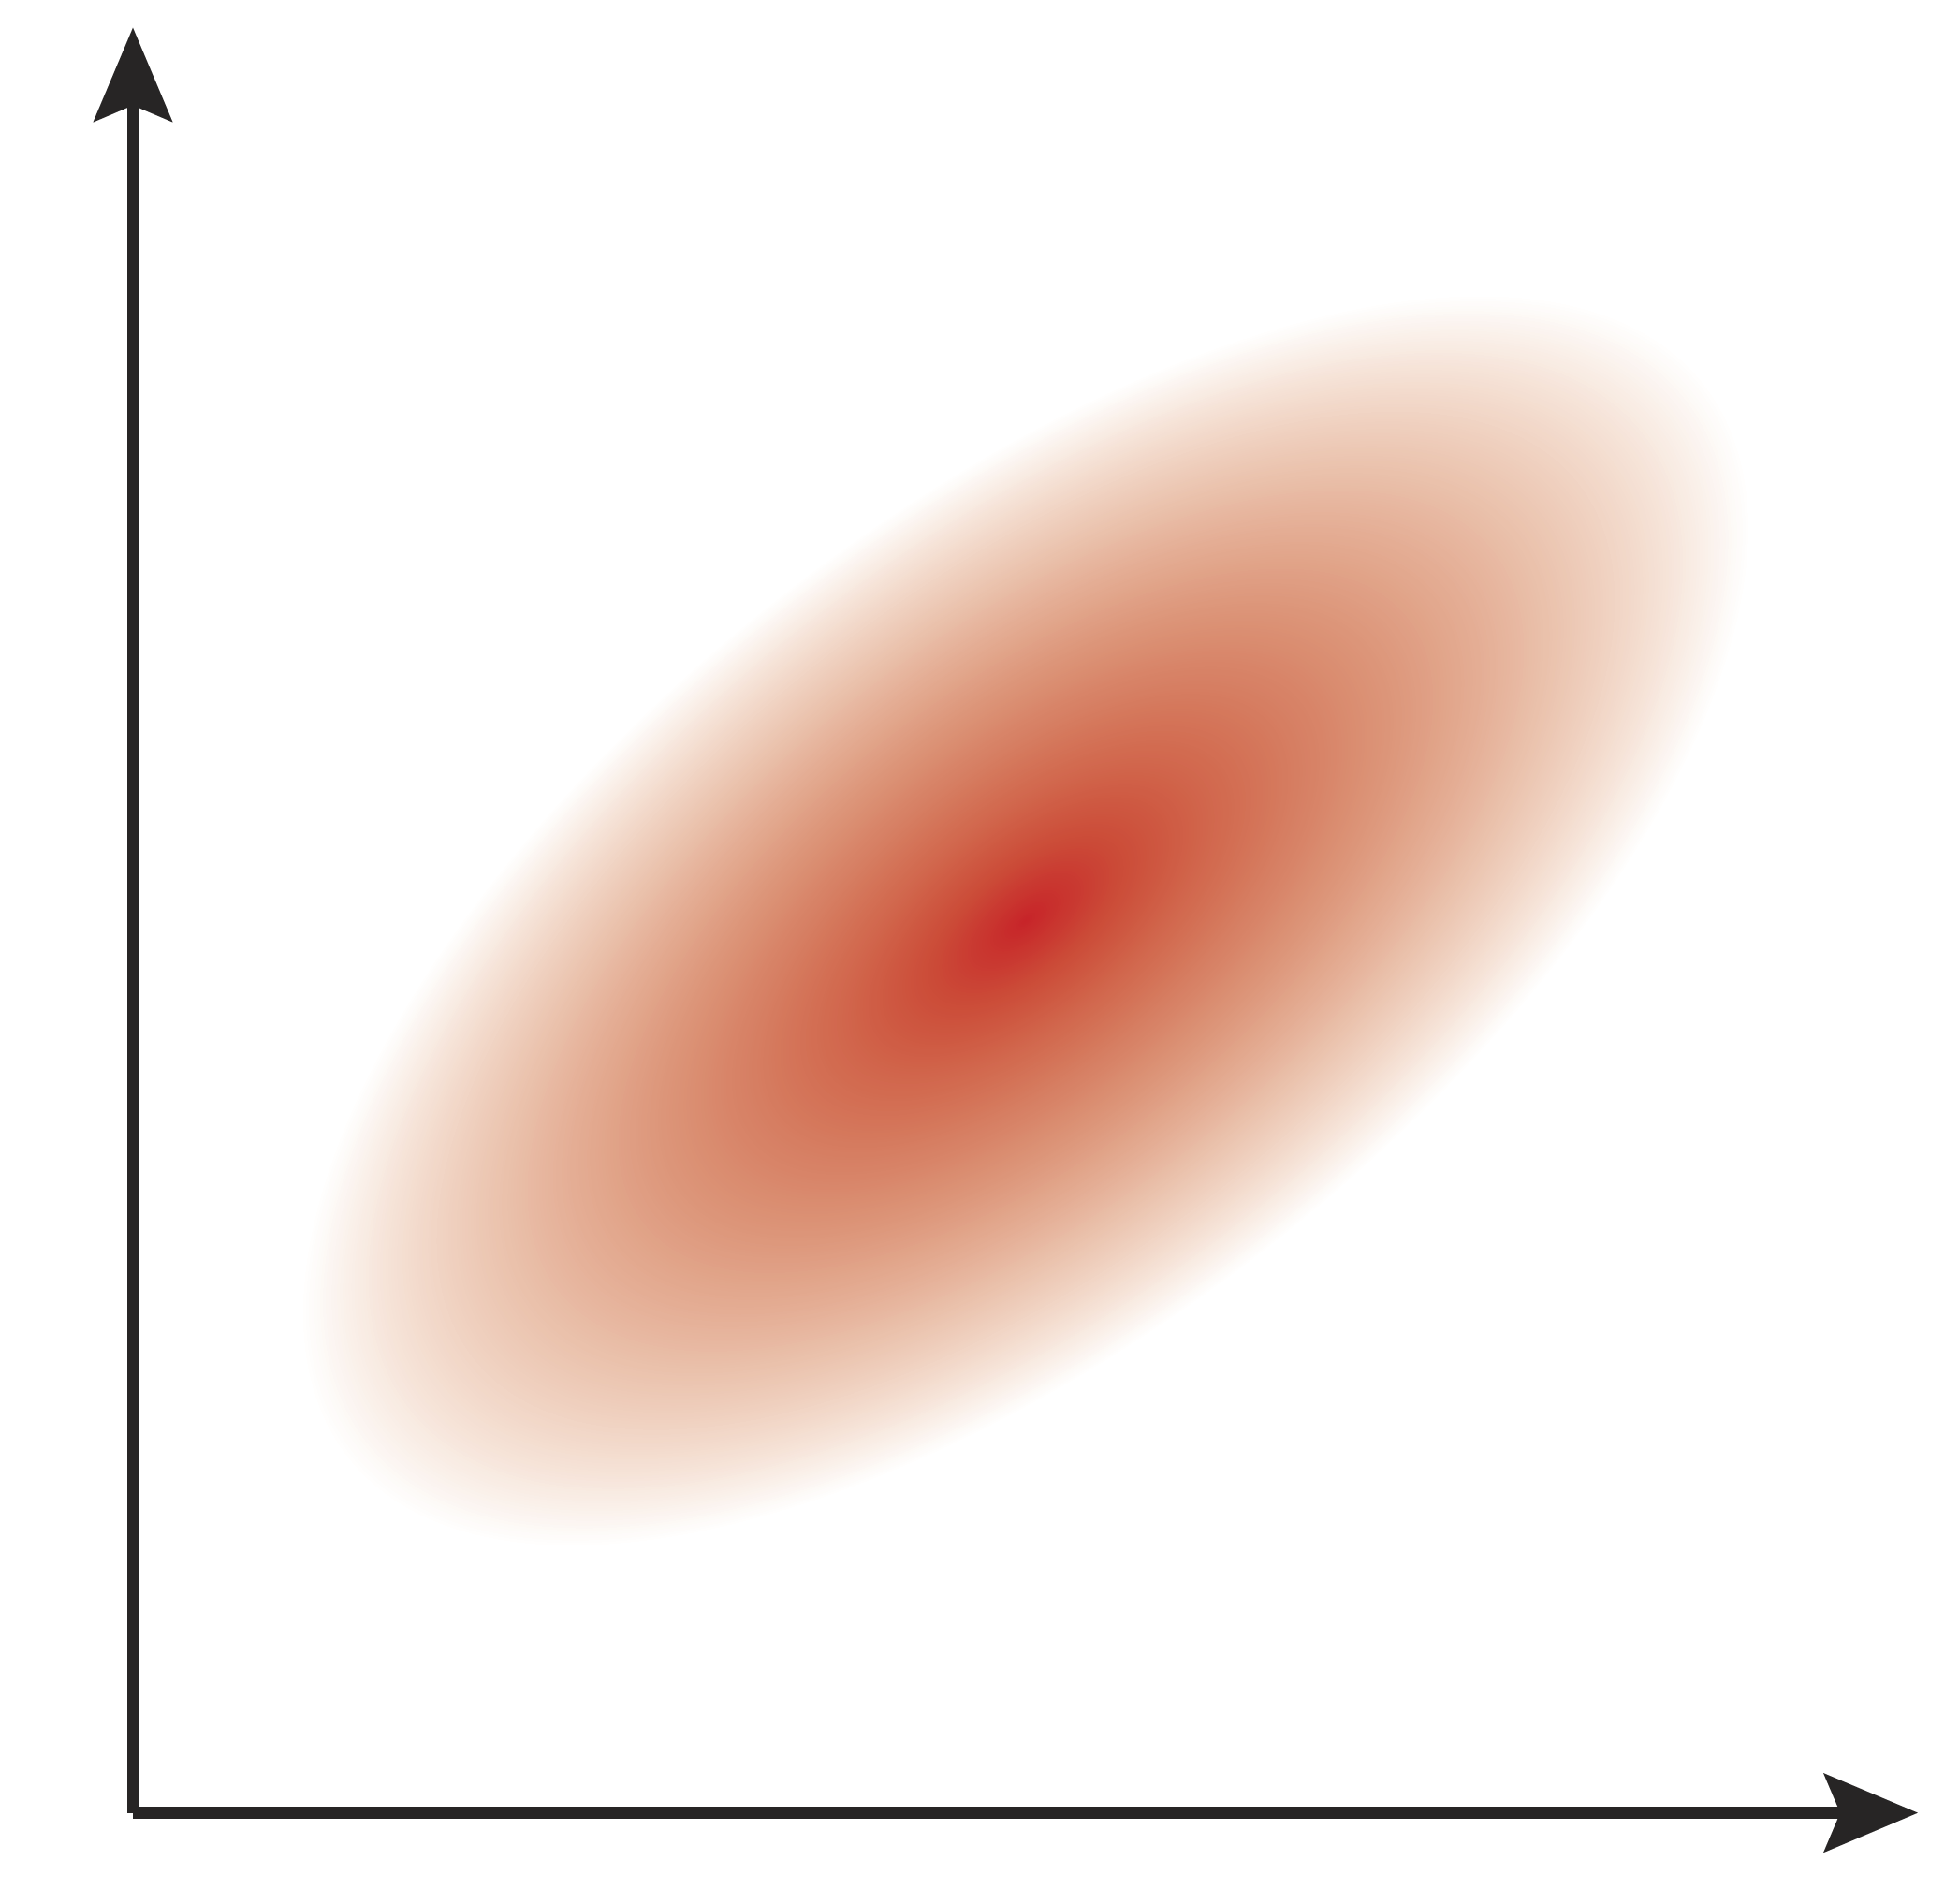
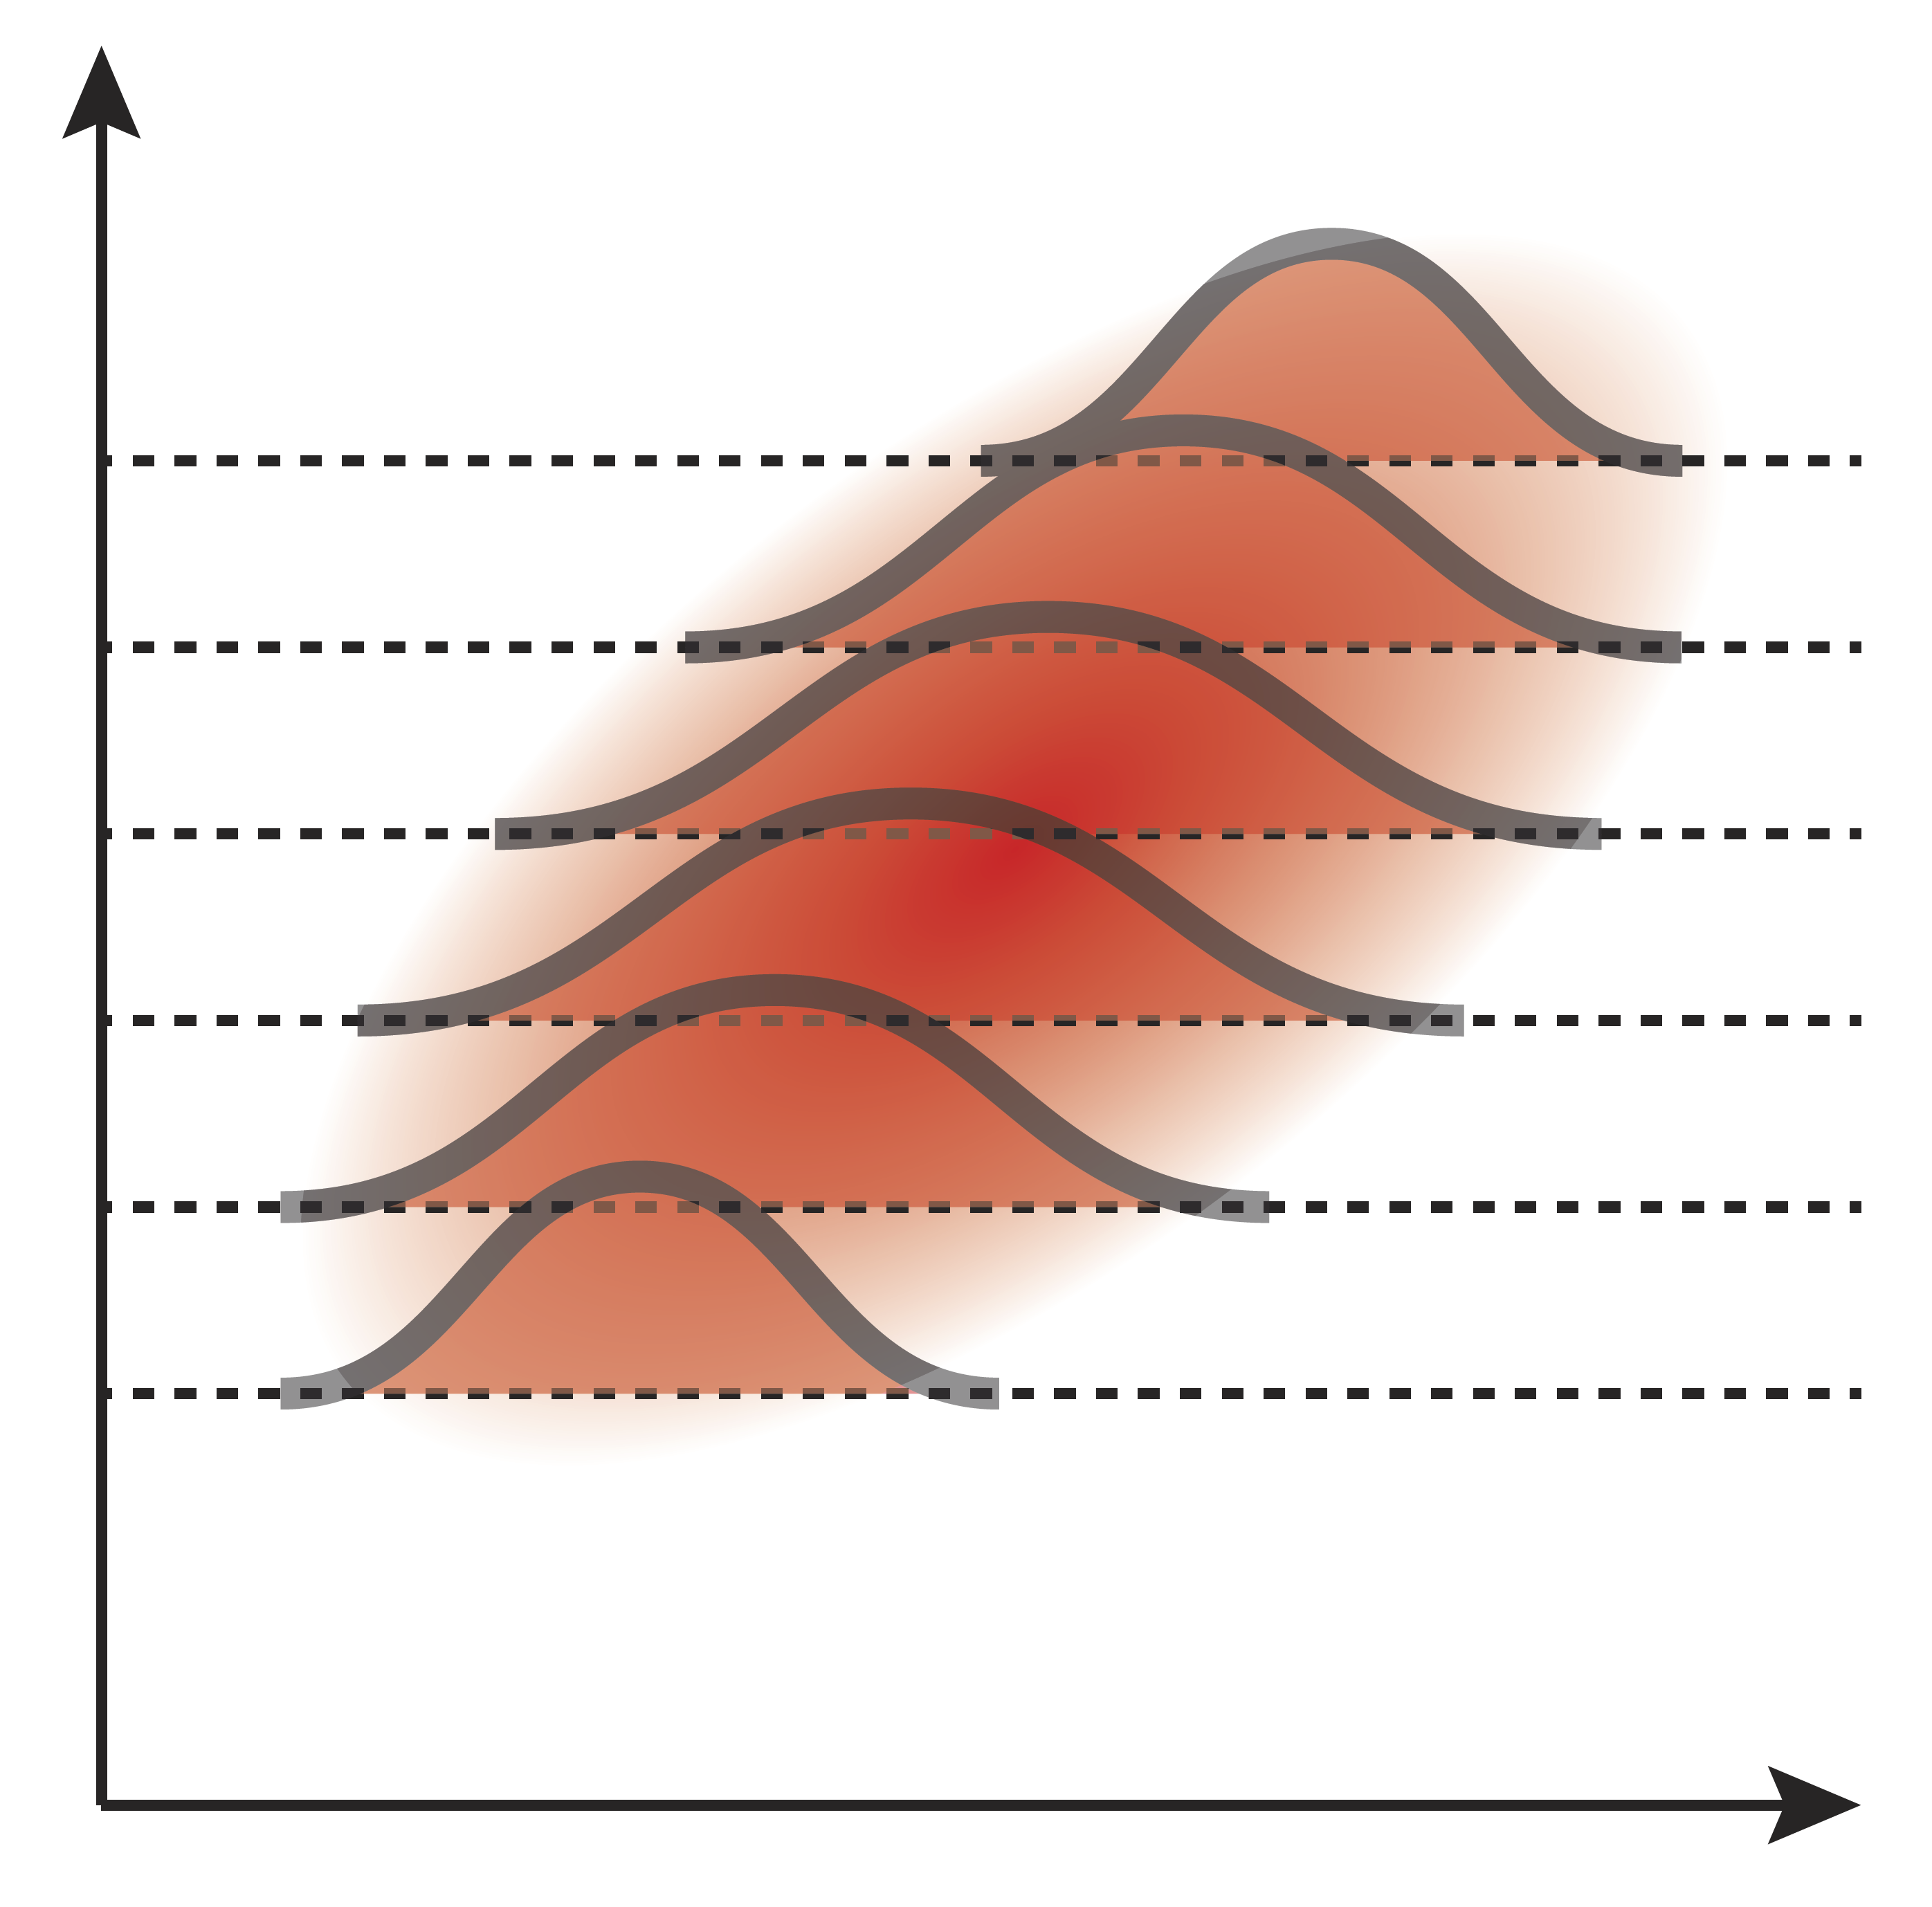
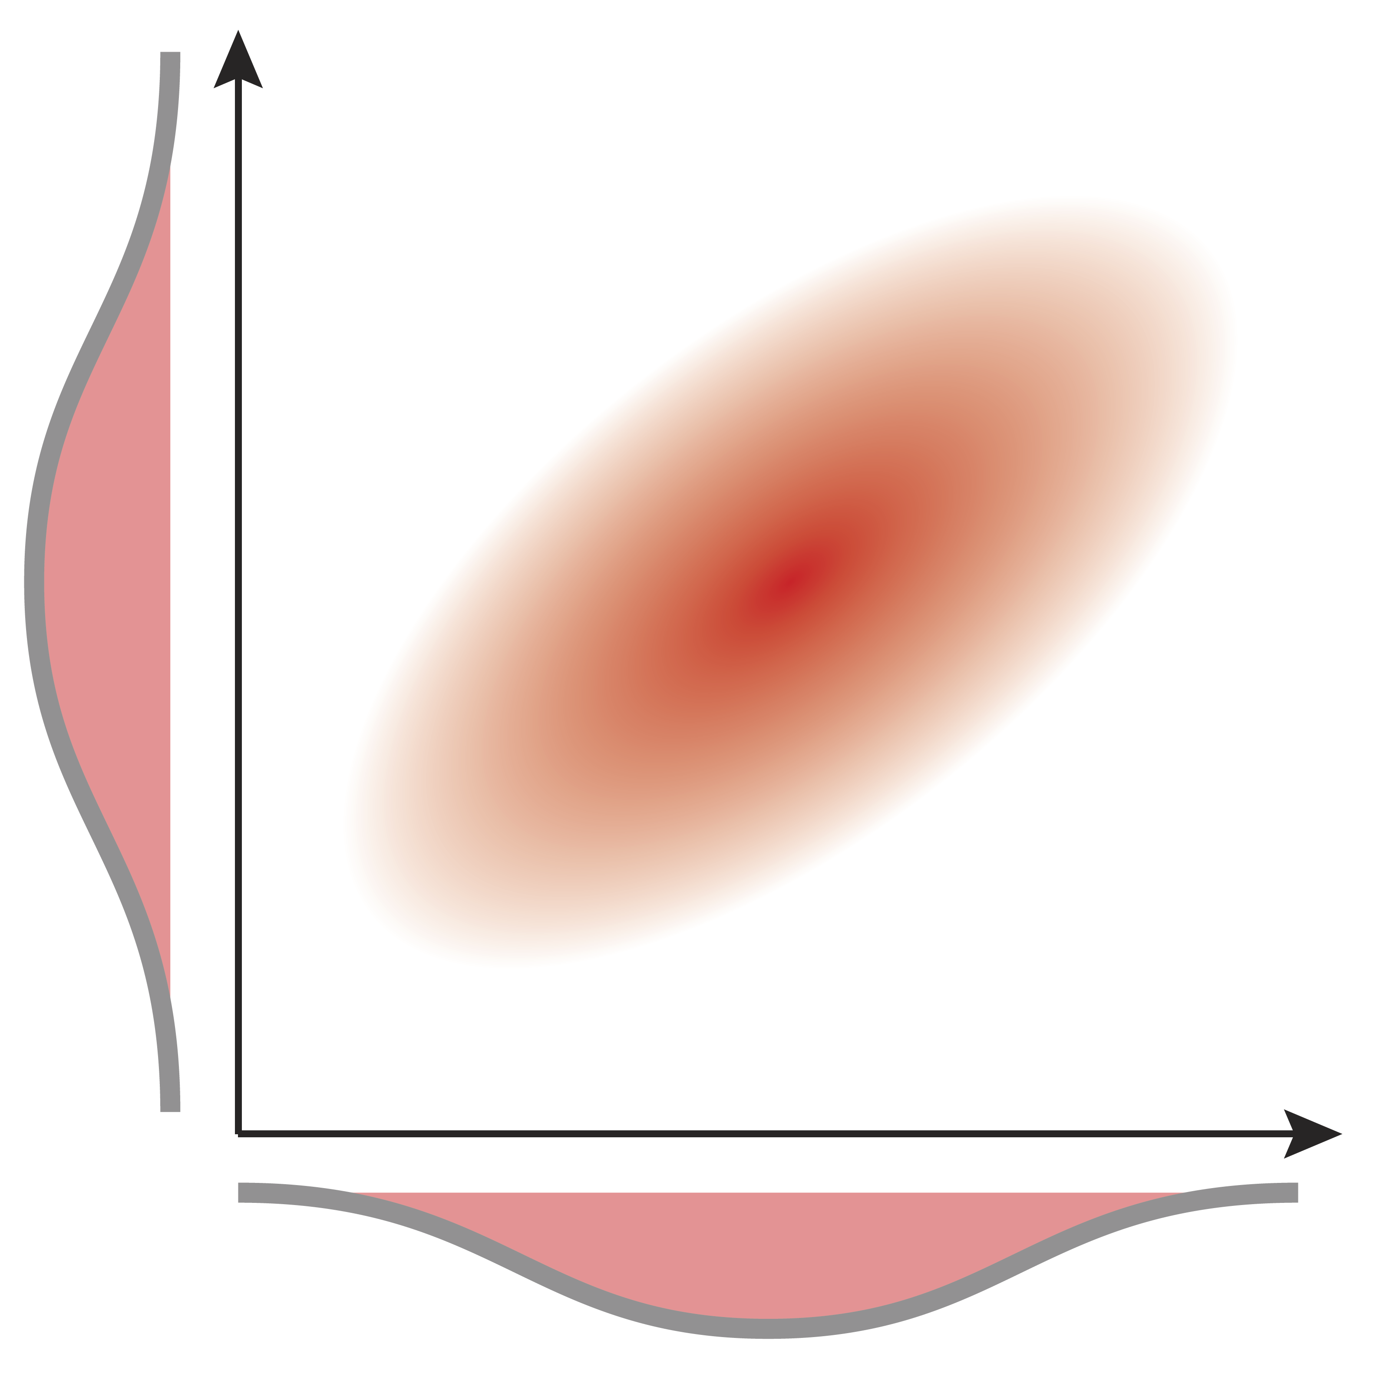
Joint, conditional, and marginal probability distributions
In general we deal with multidimensional joint posterior probability distributions, characterized by a large sample-based approximation (i.e. histograms)
MCMC builds up the joint distribution from repeatedly sampling from conditionals
We can characterize distributions or do posterior calculations anyway we want once we have the full joint distribution

Slide 23
LINEAR REGRESSION

Slide 24
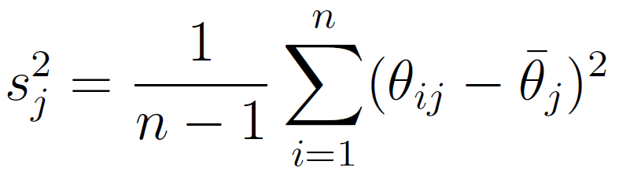
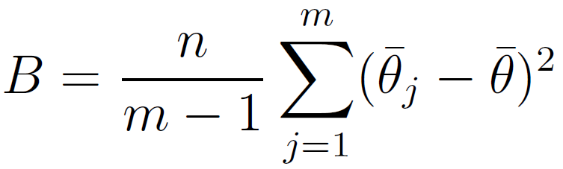
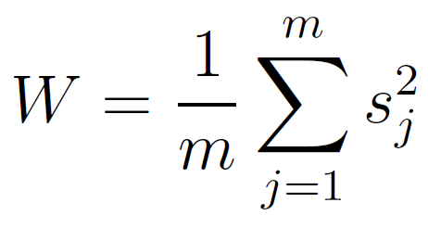
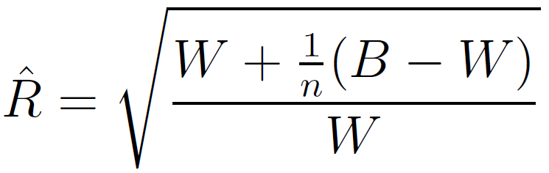
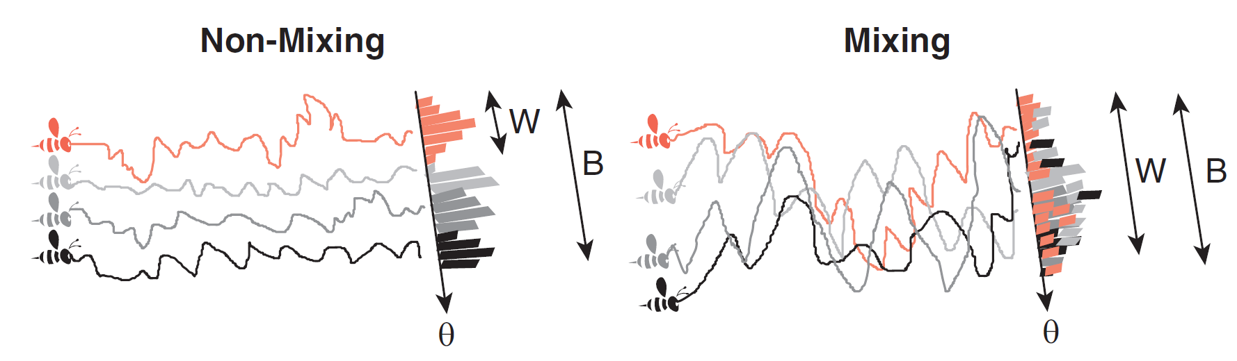
Explaining Rhat
Rhat is equivalent to an ANOVA on within vs. between chain variability -> a chain has converged (with high probability) if the within chain variability accounts for all the between chain variability (i.e. Rhat -> 1)

Slide 25
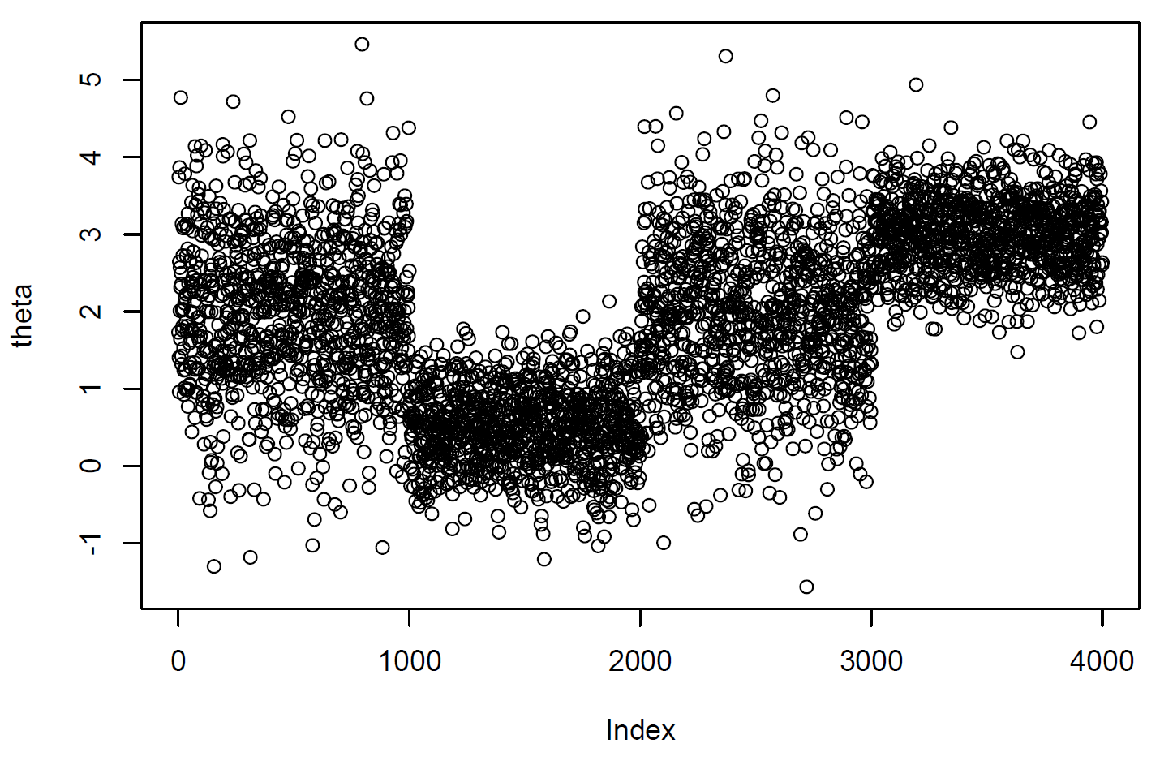
What unmixed chains look like
Chain #2
Chain #4
Chain #1
Chain #3
You should *always* run multiple chains with different initial conditions when doing MCMC
Poor mixing is usually due to too small MCMC step size

Slide 26
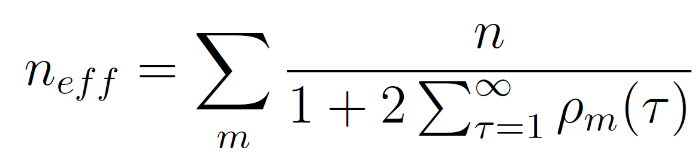
Explaining n_eff
# samples in chain
# chains
Autocorrelation of chains
Random walk MCMC chain
Hamiltonian MC chain

Slide 27

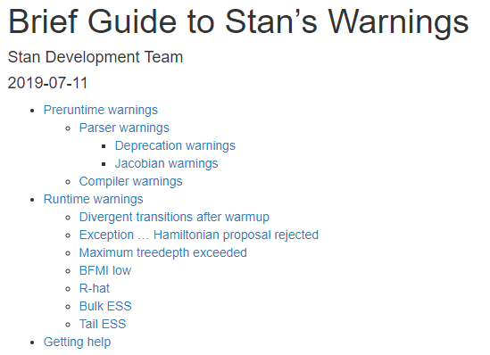






Slide 28
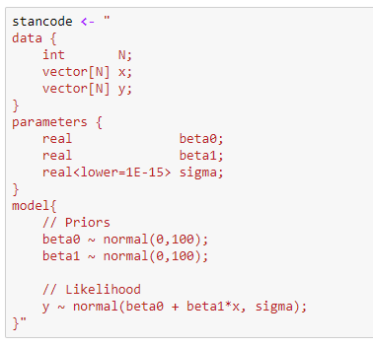
Group exercise
Read in the dataset ‘x3y.csv’ from the data folder within the linear regression case study folder. This dataset contains 3 variables: a simulated ‘x’, its square ‘x2’, and its cube ‘x3’
Modify the Stan code to read these three variables
Modify the Stan code to include a quadratic and cubed term in the regression
Compile and fit the model and look at the results
Need additional variables
Need additional parameters
Need additional regression terms

Slide 29
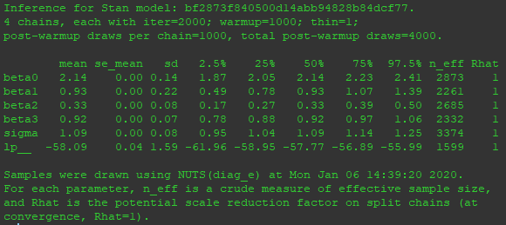
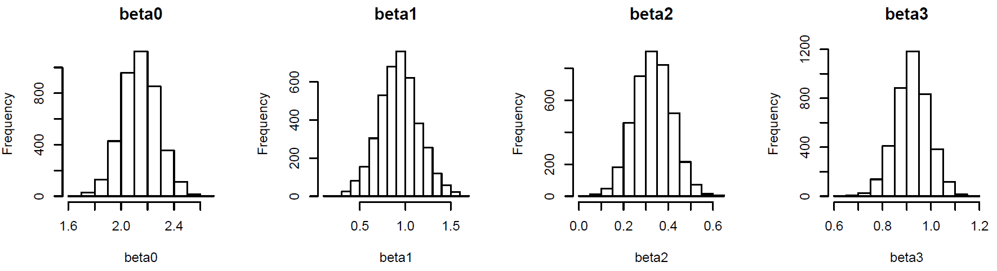
Results

Slide 30
PHYTOPLANKTON GROWTH MODEL

Slide 31
Group exercise
Plot the joint posterior distribution of gamma, lambda, and x0
Calculate the posterior correlation among these variables

Slide 32
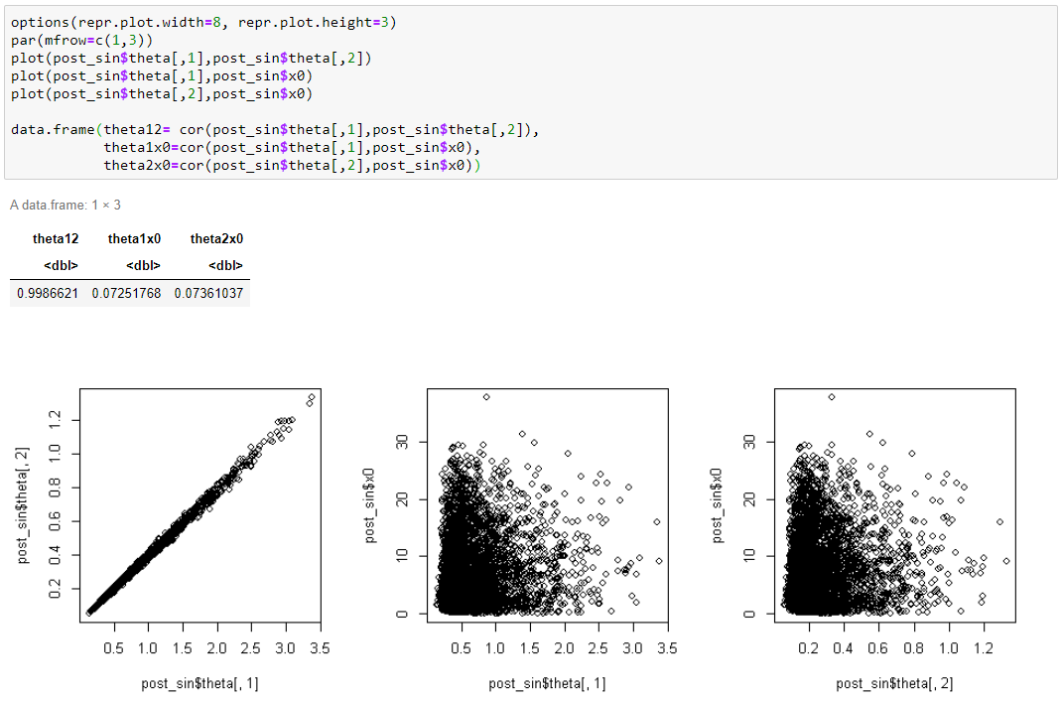
Results

Slide 33
NUTRIENTS-PHYTOPLANKTON-ZOOPLANKTON

Slide 34
PAUL SLIDES

Slide 35
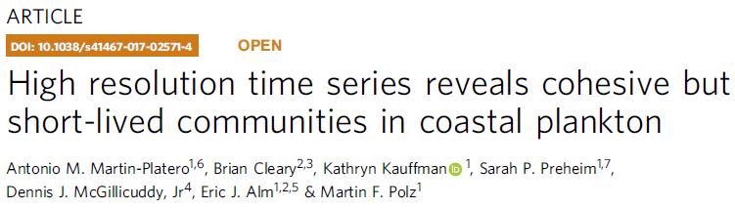
MULTIVARIATE FIRST ORDER AUTOREGRESSIVE MODEL MV AR(1)

Slide 36
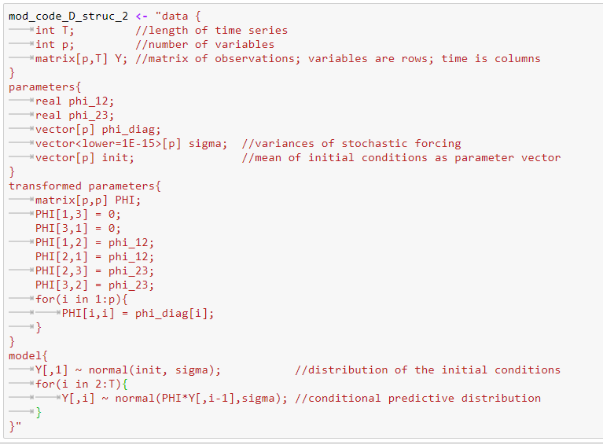
Group exercise
Use the transformed parameters block to build matrix operators from parameters (will be useful for SeaFlow model)
Can fit particular interaction structures, etc.
Try setting other parameters to zero, or specified values. See how the other estimates change

Slide 37
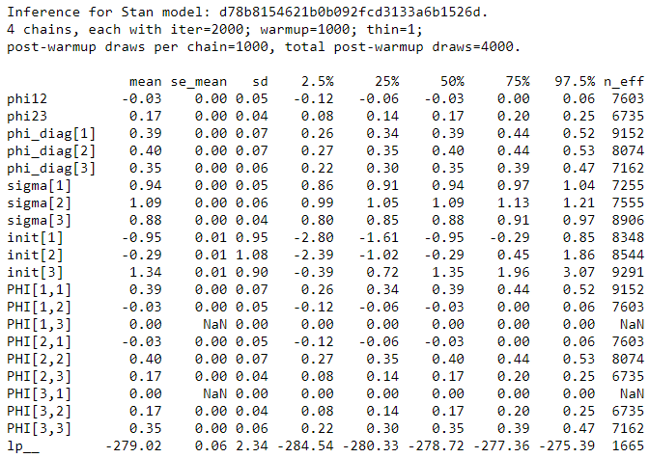
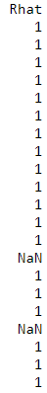
Results

Slide 38
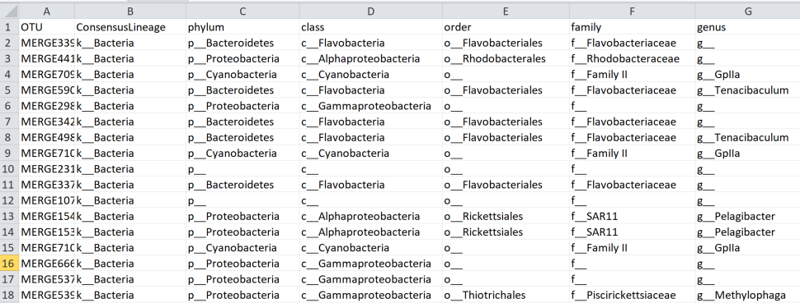
Group exercise (NPZ_narragansett.ipynb)
Try fitting the dynamics of only the two most abundance phyla
Do you recover the same interactions for those phyla when other phyla are included?
OR
Try grouping by a different taxonomic level and estimating the interactions
Note that the fitting will slow down as p increases

Slide 39
Results

Slide 40
MACROMOLECULAR MODEL

Slide 41
INSERT AW SLIDES

Slide 42
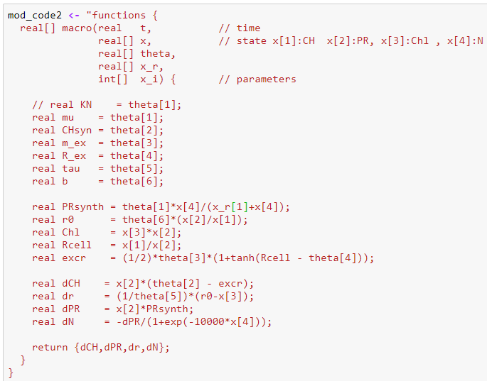

Group exercise
Try fixing some parameters and analyzing the impact on the fit

Slide 43
Results

Slide 44
SEAFLOW MATRIX POPULATION MODEL

Slide 45
SeaFlow Data
102 Size Classes
15 Size Classes
Size class abundance
Size class proportions
Total abundance

Slide 46
INSERT FRANCOIS SLIDES

Slide 47
INSERT PAUL SLIDES

Slide 48
GROUP HACKATHON BEGINS!
Join the case study you’d like to work on
Group Leaders: NPZ + Pgrowth (Mike) MV AR(1) (Greg) SeaFlow (Francois/Paul) Macromolecular (AW)
Brainstorm analysis ideas What is your scientific question? How will you use or modify a model? How will you assign prior distributions to model parameters? How will you assess the fit of the model? What analysis does your question require? Parameter estimation? Prediction? Model selection?
Come back together to present and discuss ideas as a group

Slide 49
Some hackathon ideas to get you started
One compartment P growth model
NPZ model
Test different forms for the seasonal nutrient supply
Try fitting the univariate growth model to the P time series
Multivariate AR(1)
Evaluate the strength of interactions between and within phyla
Compute the distribution of matrix eigenvalues
Macromolecular model
Functional form for nutrient uptake
Model the diel cycle
Matrix population model
Fit the model to Zinser data (FCS)
Incorporate population size into
Examine the importance of model resolution
Different error distributions (Dirichlet, normal-approx. to bernouli, effective sample size)

